Slide 1
GROCERY DELIVERY APPLICATION
Kaviya S - EBEON1222714256
Priyadharshini C - EBEON1222705676
Aarthy S - EBEON1222708290
Ranjithapriya T -EBEON1222722728
Guided by
Varadharajan A

Slide 2
ABSTRACT
An online Grocery store permits a customer to submit online orders for items and/or services from a store that serves online customers.The online store system provides an online display of all the items they want to sell.This web based application helps customers to choose their daily needs and products to their shopping cart.Customers provide their complete detail of address and contact and they get their chosen products in their home.

Slide 3
LIST OF MODULES
Registration and Login
Home Page
Chat Bot
Product Category
Order and Payment History
Cart Process
Payment Process
SMS Sending
GPS Tracking

Slide 4
TOOLS USED
Spring boot
Maven
Java8
My SQL
Hibernate
Angular
Html
CSS
Java script
Typescript

Slide 5
REGISTRATION AND LOGIN
REGISTRATION
A registered user is a user of a website, program, or other systems who has previously registered. Registered users normally provide some sort of credentials (such as a username or e-mail address, and a password) to the system in order to prove their identity: this is known as logging in.
LOGIN
In general computer usage, logon is the procedure used to get access to an operating system or application, usually in a remote computer. Almost always a logon requires that the user have (1) a user ID and (2) a password.

Slide 6
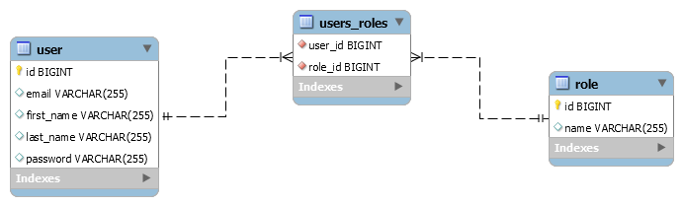
DATABASE DESIGN

Slide 7
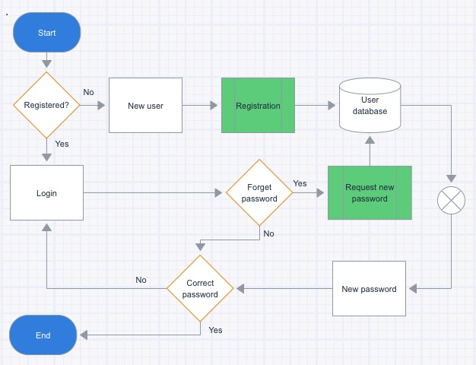
FLOW CHART

Slide 8
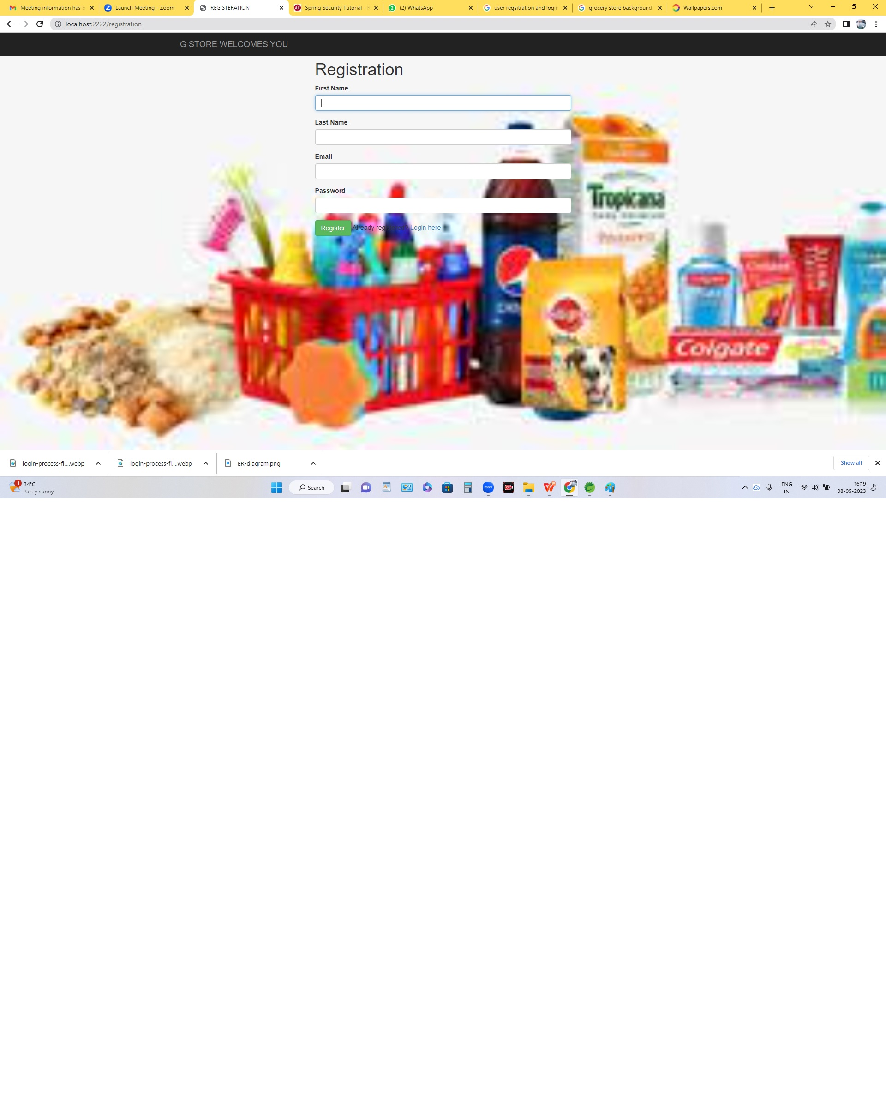
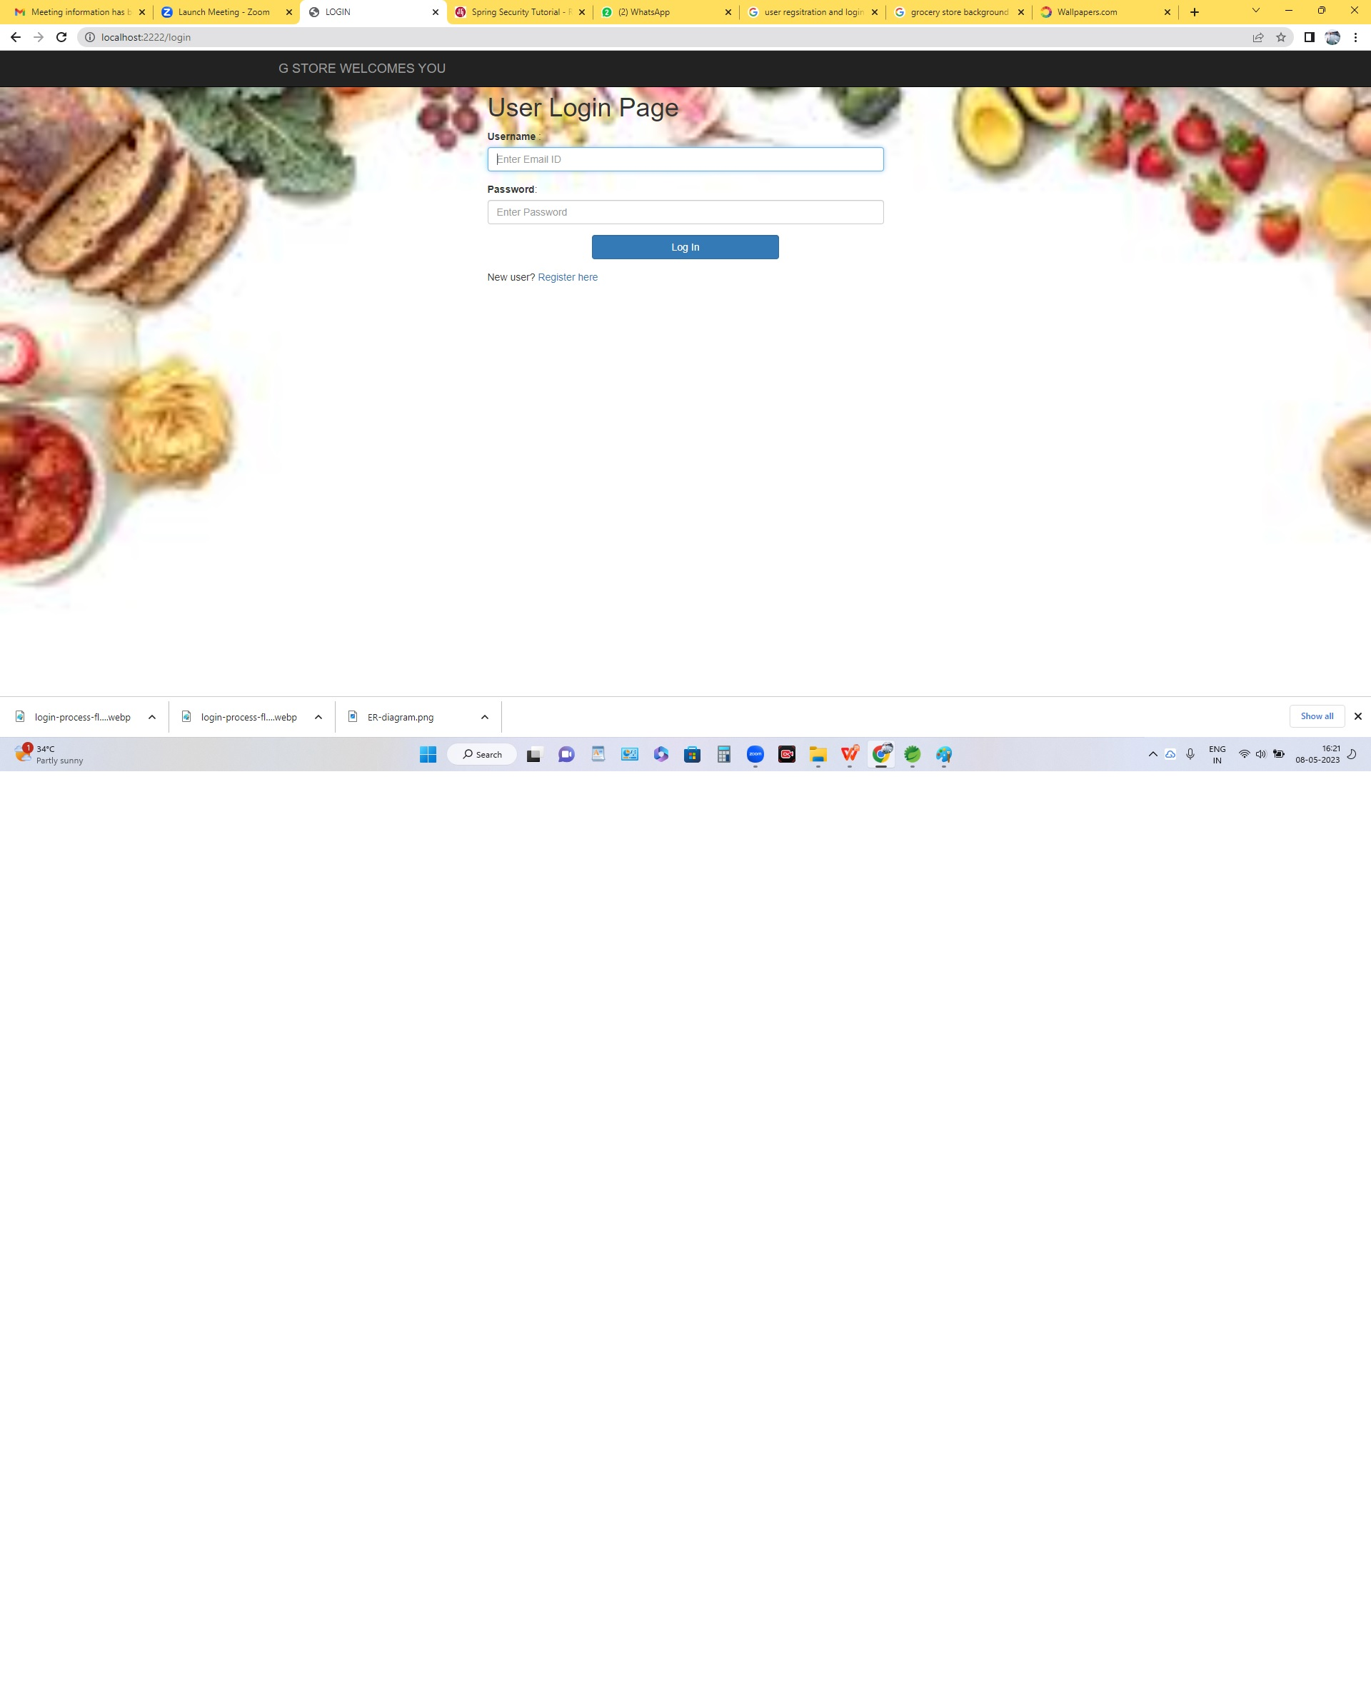

Slide 9
HOME PAGE
The homepage, or homepage, is a page that serves as the starting point of the website.
This is the default web page that loads when you visit an address that contains only one domain name.

Slide 10
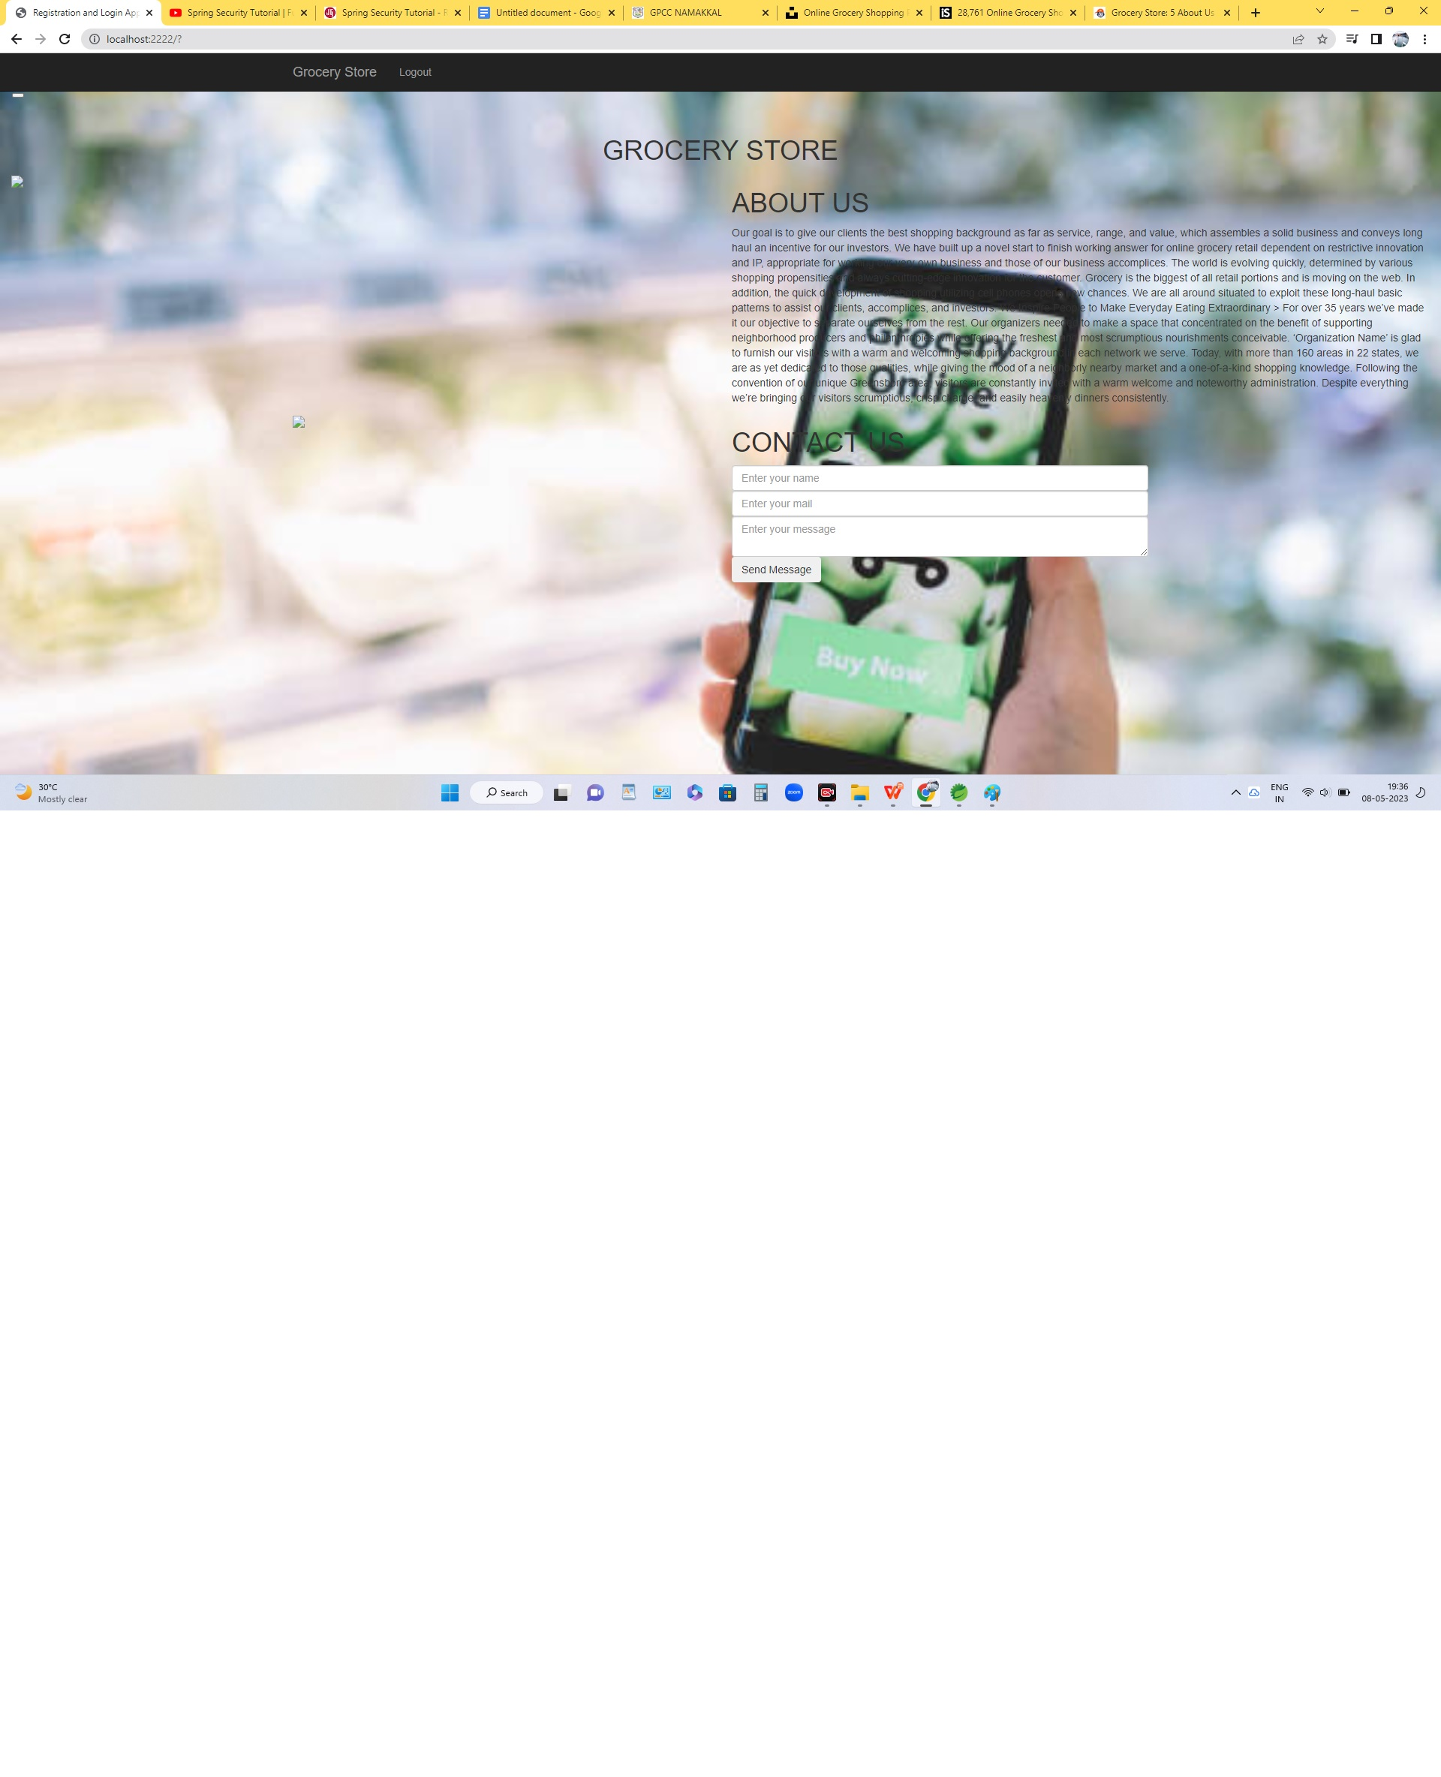
OUTPUT

Slide 11
CONCLUSION
Online shopping is becoming more popular day by day with the increase in the usage of World Wide Web ,Understanding customer’s need for online selling has become challenge for marketers .Specially understanding the consumer’s attitudes towards online shopping , making improvement in the factors that influence consumers to shop online and working on factors that affect consumers to shop online will help marketers to gain the competitive edge over others.

